Slide 1

شروع کرتا ہوں اللہ کے پاک نام سے جو بڑا مہربان اور نہایت رحم کرنے والا ہے۔

Slide 2
ADMISSION SYSTEM for
AJK Nomination Board
Developed and Designed By: technoSpyre. Inc

Slide 3
Student Portal – Key Features
  Registration and Login
  Personal Information
  Manage Educational History
  Application-wise Preferences
  Printing of Applications
  Applications status

Slide 4
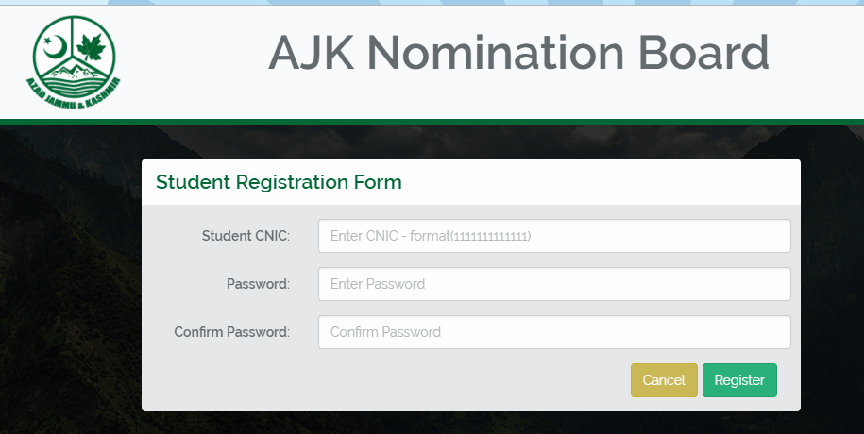
Student Portal - Registration Form

Slide 5
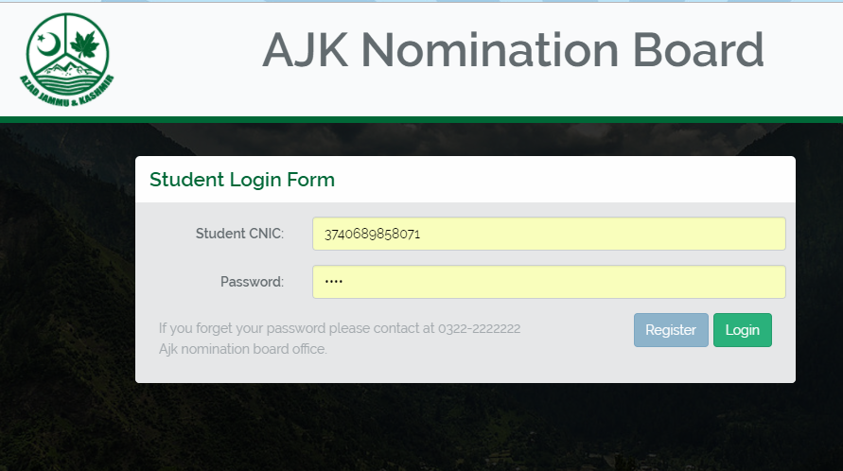
Student Portal - Login Form

Slide 6
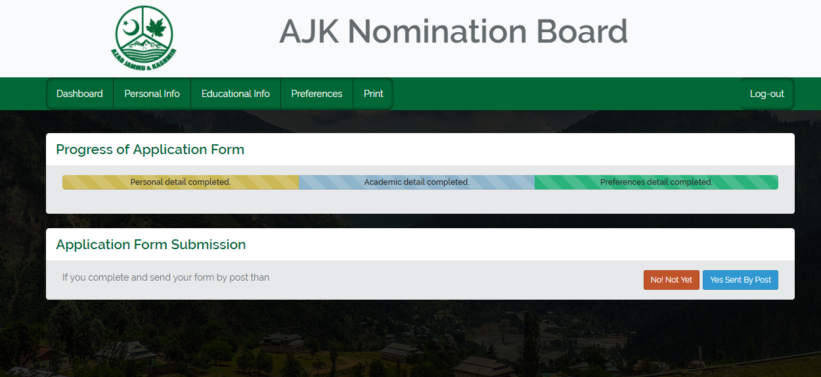
Student Portal - Dashboard

Slide 7
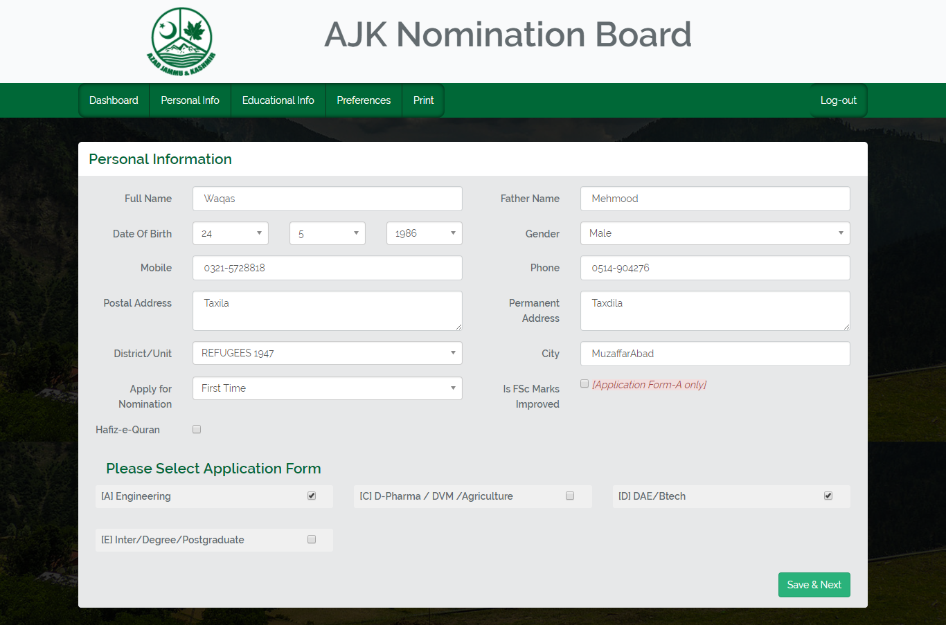
Student Portal - Personal Information

Slide 8
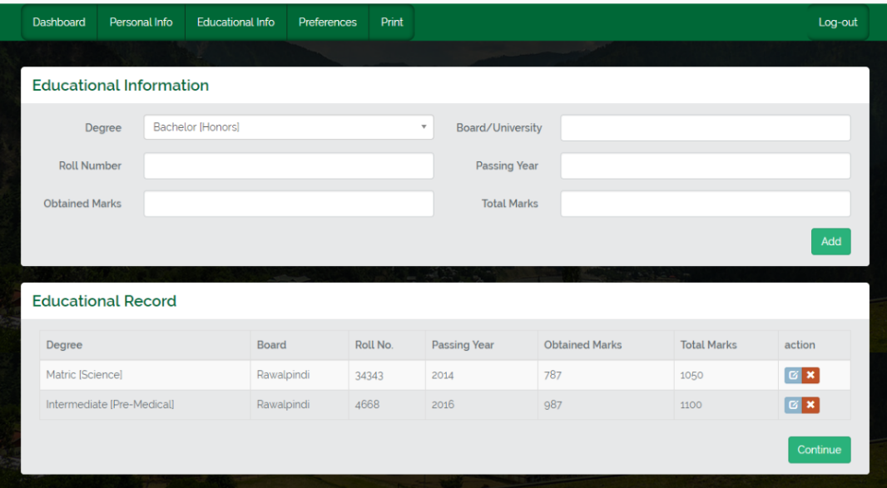
Student Portal - Educational History

Slide 9
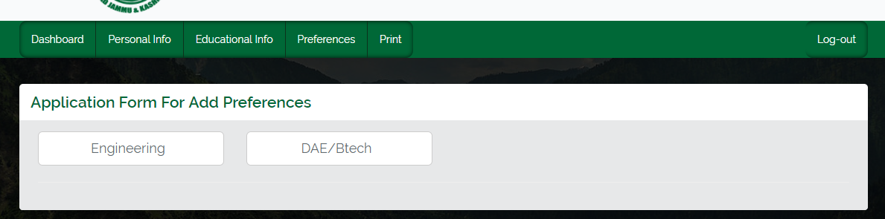
Student Portal - Pick Application Type for Preference

Slide 10
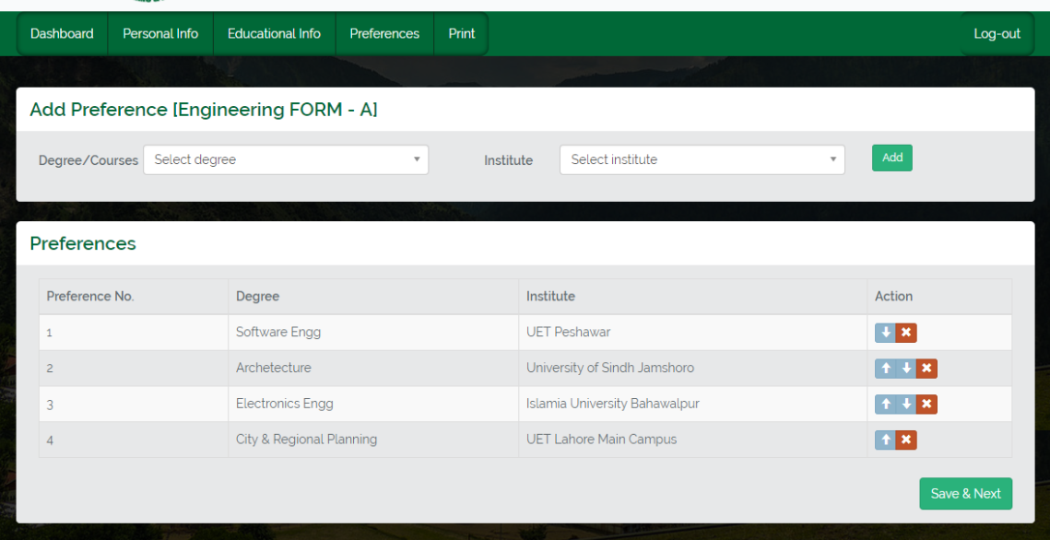
Student Portal - Select Preferences

Slide 11
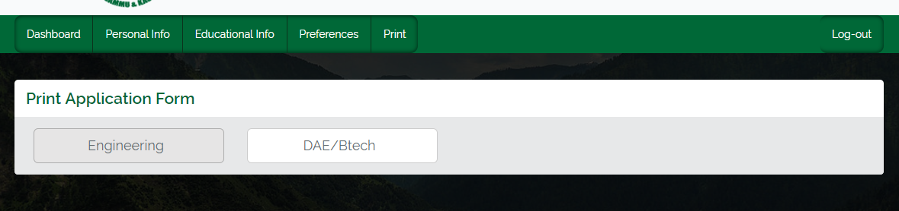
Student Portal - Print Application Form

Slide 12
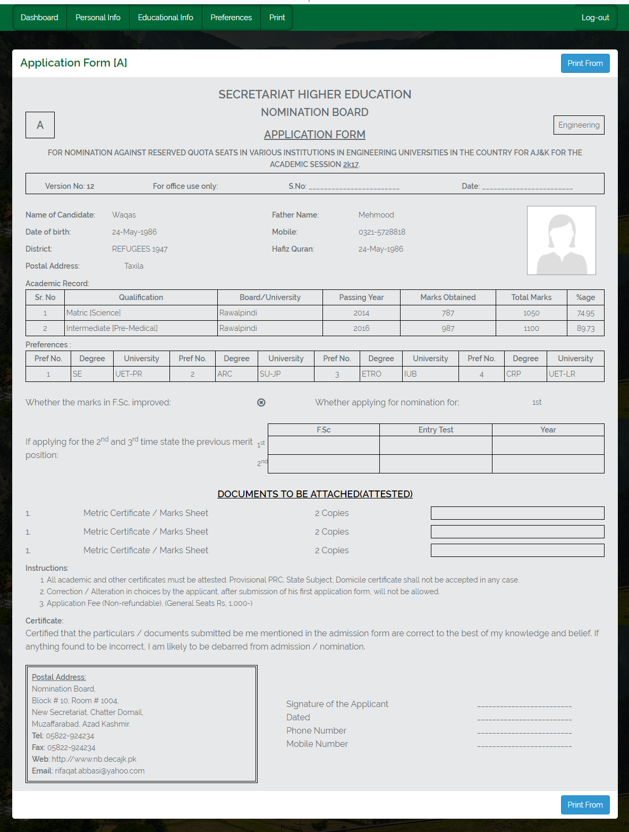
Student Portal - Take Print

Slide 13
Admin Portal
  Admin can …
    Login using pre-allotted credentials
    Create or remove extra admins
    Setup following for student portal
      Admission Session - Application Types
      Institutes - Degrees - Districts - Quotas
      Degree Levels and
      Seat Allocation with Rules of admission

Slide 14
Admin Portal
  Admin can …
    Submit student application for auto-generation of application number by the system.
    Edit student personal information and educational information
    Delete Application Form
    Search student on the basis given criteria
    Generate Merit and View Merit List
    Perform further actions for admitted students

